Slide 1

GAME Hub Data Base

Slide 2

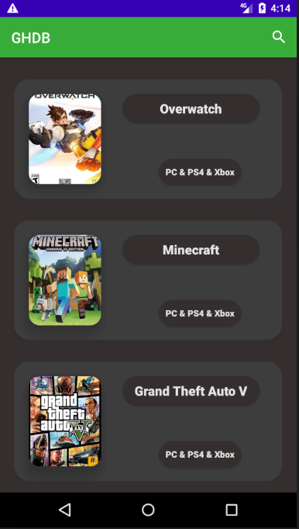
Acts as an intermediate between you and the gaming market.
01
A catalog of video games for different consoles and platforms.
02
Track your favorite games.
03
04
Find new games.

Slide 3


Works like magic
Simplicity
Easy to download
Your pocket friend
User friendly design

Slide 4
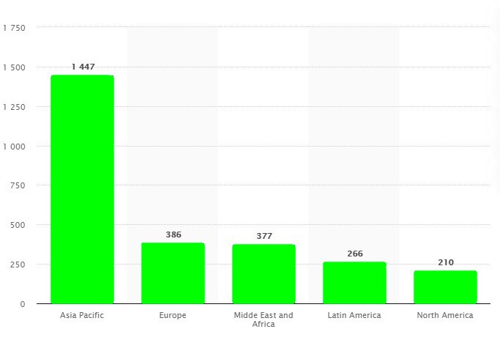
OUR COMMUNITY
01
Gaming by region.

Slide 5
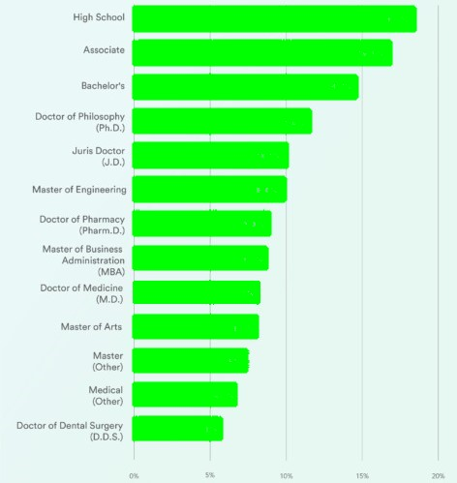
18.5%
02
16.9%
14.7%
11.6%
10.1%
Gaming by education level.
10.0%
9.0%
OUR COMMUNITY
8.7%
8.3%
8.2%
7..4%
6.7%
5.8%

Slide 6
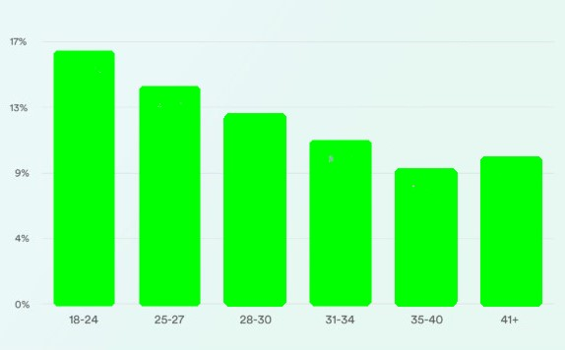
OUR COMMUNITY
16.3%
14.0%
12.2%
10.5%
9.4%
8.6%
03
Gaming by age

Slide 7
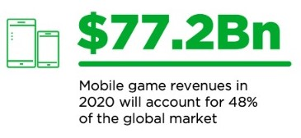
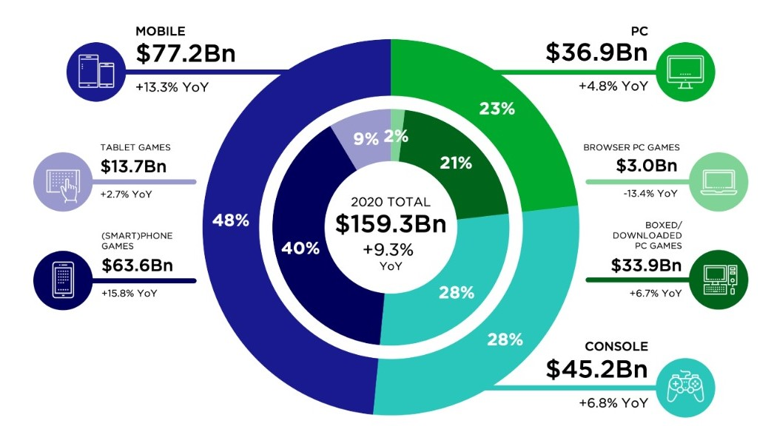
OUR COMMUNITY
04
Global games market 2020.

Slide 8

UPCOMING
GOAL
05
05 Partnership with any market application that sells games.
04 Our project shell can provide us a wide range of variations for different types of applications such as movie database, board games database, hardware database, music database.
04
03
03 Log in features in order to be able to save your favorite games and to track sales for a selected game.
02
02 Forum to connect the community and talk about different games.
01
01 Contact support.

Slide 9
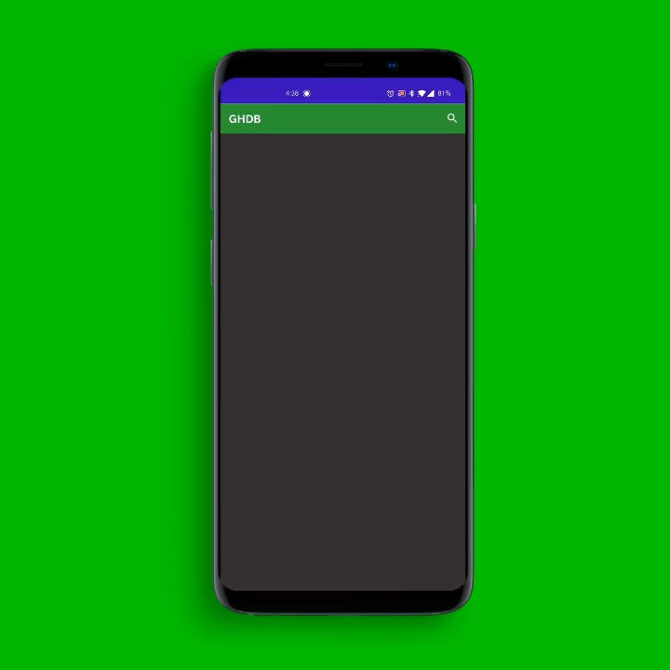

Slide 10


Links:
Website - ghdb.io
GHDB Source Code – github.com
GHDB Downloadable APK – github.com
OUR TEAM:
Bălan Mihai – UX & Project Manager
Nichita Andrei-Cătălin – Developer
Aelenei Bogdan-Ștefan – Business
Al Khatib K. Mariam – Business

